Slide 1


Main Project Examination – 20CIP87
Department of CSE (AI & ML)
Nagarjuna College of Engineering and Technology, Bengaluru

Slide 2
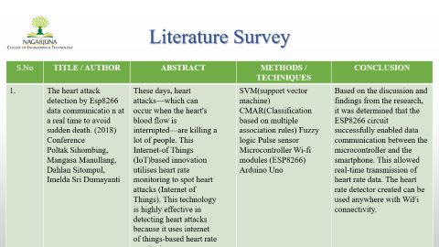
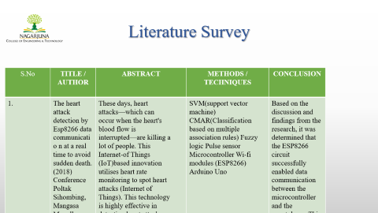
Main Project Examination – 20CIP82
SMARTWATCH-BASED HEART ATTACK DETECTION AND HEALTH MONITORING SYSTEM
Student Names | USN Number
1. Abhishek KN 2. Rajan Kumar R 3. Swathi G | 1NC20CI001 1NC20CI031 1NC2OCI040
Under the guidance of Prof. Vijayakala Asst. Professor

Slide 3
Introduction
In recent years, the integration of technology into our daily lives has been transformative, particularly in the realm of personal health management. Among the various technological innovations, smartwatches have emerged as indispensable tools, offering a comprehensive approach to well-being.
Our project, the "Smartwatch-Based Heart Attack Detection and Health Monitoring System with Integrated GPS and Notification App," is at the forefront of this technological revolution. By seamlessly combining advanced features such as heart attack detection, GPS tracking, and real-time notifications, our initiative aims to empower individuals to proactively control their cardiovascular health. The ubiquity of smartwatches and continuous advancements in health monitoring technologies provide a fertile ground for this transformative approach.

Slide 4
Literature Survey
S.No | TITLE / AUTHOR | ABSTRACT | METHODS / TECHNIQUES | CONCLUSION
1. | The heart attack detection by Esp8266 data communicatio n at a real time to avoid sudden death. (2018) Conference Poltak Sihombing, Mangasa Manullang, Dahlan Sitompul, Imelda Sri Dumayanti | These days, heart attacks—which can occur when the heart's blood flow is interrupted—are killing a lot of people. This Internet-of Things (IoT)based innovation utilises heart rate monitoring to spot heart attacks (Internet of Things). This technology is highly effective in detecting heart attacks because it uses internet of things-based heart rate monitoring. | SVM(support vector machine) CMAR(Classification based on multiple association rules) Fuzzy logic Pulse sensor Microcontroller Wi-fi modules (ESP8266) Arduino Uno | Based on the discussion and findings from the research, it was determined that the ESP8266 circuit successfully enabled data communication between the microcontroller and the smartphone. This allowed real-time transmission of heart rate data. The heart rate detector created can be used anywhere with WiFi connectivity.

Slide 5
Literature Survey
S.No | TITLE / AUTHOR | ABSTRACT | METHODS / TECHNIQUES | CONCLUSION
2 | IoT based Heart Attack Detection and Heart Rate Monitoring System. (2023) IEEE Authors: Dr. T. Arun Prasath M.Mohamed Arif S Srinivasan A Muthumanoj kumar M Sushmitha Sakthivel Sankaran | IOT innovation effectively detects heart attack by utilizing heart rate monitoring. It enhances accuracy of detection. The continuously measures heart rate, providing a protective approach to identify potential heart attack and enabling timely intervention | C Programming language Android Smart Phone Arduino uno Pulse sensor ECG sensor GPS sensor WIFI Modul | Our system is flexible and can monitor various cardiovascular factors at the same time, such as heart rate, circulatory load, and patient temperature. The collected data is sent wirelessly using Bluetooth to an Android mobile device, which then transmits it to a web application for further monitoring and control.

Slide 6
Literature Survey
S.No | TITLE / AUTHOR | ABSTRACT | METHODS / TECHNIQUES | CONCLUSION
3 | Heart rate monitoring system for patient with coronary heart disease with IoT: initial idea 2022 Authors: Y. Omar, I. Ismail, M.Harith | Many people worldwide lack proper access to hospitals and health monitoring, impacting their wellbeing. Fortunately, with advanced technology, small wireless solutions connected to IoT allow remote patient monitoring, eliminating the need for frequent hospital visits. For individuals in smart cities, especially those who are elderly or disabled, daily mobile healthcare services are crucial. | ECG Pulse Sensor Arduino Processor | The proposed health monitoring system aims to enhance patient care and improve the quality of life, specifically focusing on heart rate monitoring. It is designed for easy access and monitoring by family members, particularly beneficial for individuals with Chronic Heart Failure (CHF) requiring continuous care at home.

Slide 7
Problem Statement
Heart attack is one of the causes of death at this time. A person may not realize that he suddenly experiences an improper heartbeat so that a sudden heart attack can result in sudden death.
Usually a traditional heart rate calculation has been done using hardware such as oximeters or ECG. The use of ECG devices takes a long time to carry out the process.

Slide 8
Objectives
Provide resources within the smartwatch interface to educate users about their health data.
Integrate communication features for interaction with emergency services during critical events.
Allow users to set and track personalized health goals.
Create a system for secure storage and analysis of historical health data.
Encourage proactive health management and lifestyle choices.

Slide 9










Methodology
Oxygen level
Smartwatch
P
atien
t Data
Data S
torage
Temperature
Alerts
GSM Module
P
ulse
ESP 32
GPS Tracker
Heart Rate Data
Location Data
Heart Rate and Location Data
Ale
rt
Notification
Mobile App
Data Transmission
Health
Monitoring
Notification System
Internet
Data Storage
Pre
-
Registered
Users

Slide 10
Software Requirements
Python IDE
Arduino IDE Software
Mobile Application
Thingview
Blynk Iot

Slide 11
Hardware Requirements
GPS Tracker
Temperature sensor
Oxygen sensor
Pulse sensor
LED Screen

Slide 12
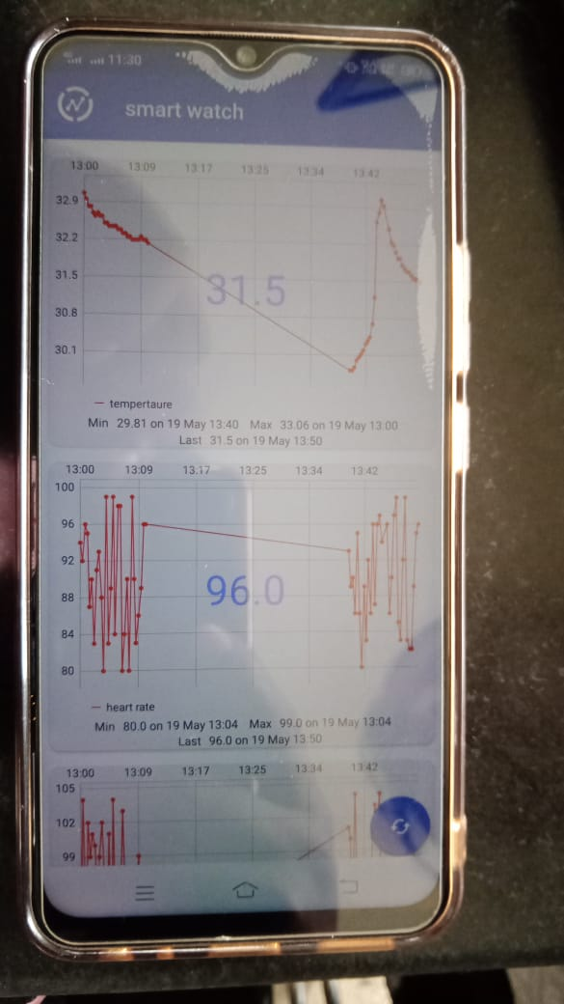
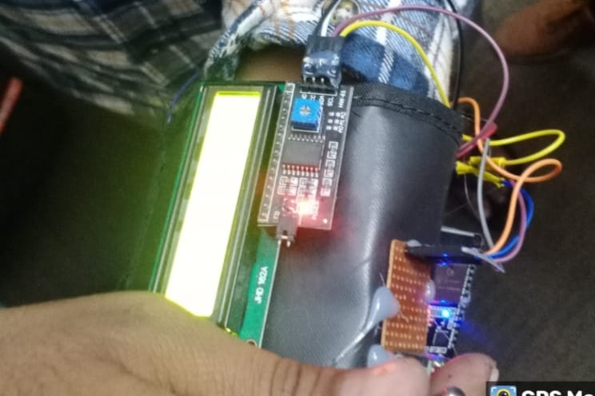
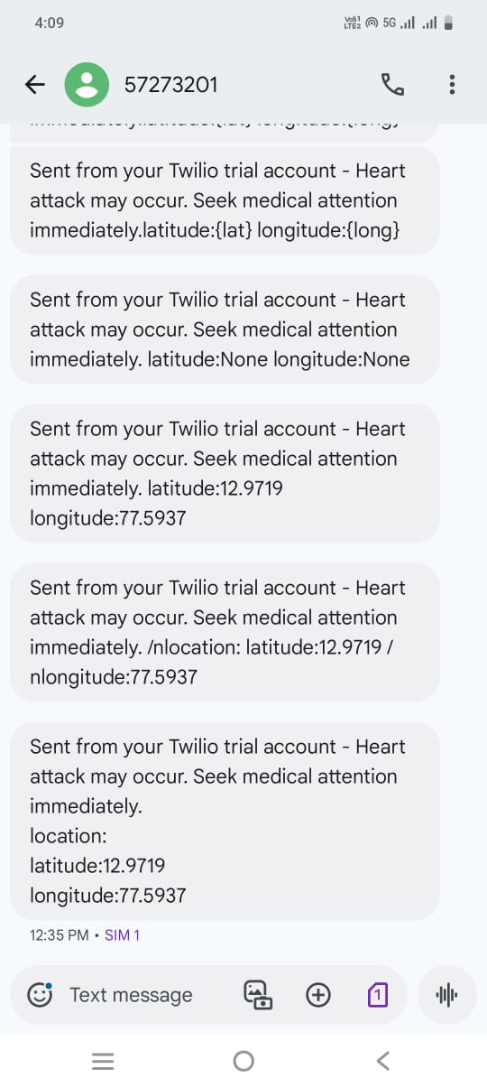
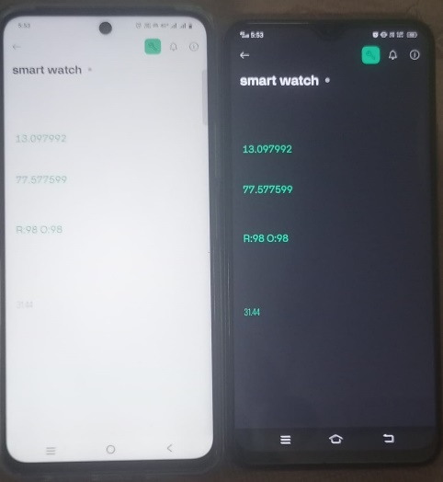
Experimental Results

Slide 13
Conclusion
The heart attack detection technology has the potential to save lives by enabling early intervention and reducing the time between symptom onset and medical assistance.
The successful implementation of such a system could significantly enhance the efficiency of emergency medical services and positively impact patient outcomes in cases of heart attacks.

Slide 14
References
1. Lahiru Colombage, Thisari Amarasiri, Tilshini Sanjeewani, Chirantha Senevirathne, Rrubaa
Panchendrarajan “SmartCare: Detecting Heart Failure and Diabetes using Smartwatch” Faculty of
Computing, Sri Lanka Institute of Information Technology Malabe, Sri Laka
2. Poltak Sihombing, Mangasa Manullang, Dahlan Sitompul, Imelda Sri Dumayanti “The Heart Attack
Detection by ESP8266 Data Communication at a Real Time to Avoid Sudden Death” Faculty of Computer
Science and Information Technology, Universitas Sumatera Utara, Faculty of Computer Science,
Universitas Methodist Indonesia
3. Dr. T. Arun Prasath Department of Biomedical Engineering Kalasalingam Academy of Research and
Education Krishnankoil, India.” IoT Based Heart attack Detection and Heart Rate Monitoring System”
M.Mohamed Arif Department of Biomedical Engineering Kalasalingam Academy of Research and
Education Krishnankoil, India. S Srinivasan Department of Biomedical Engineering Kalasalingam
Academy of Research and Education Krishnankoil, India

Slide 15
References
4. Safial Islam Ayon, Md. Milon Islam & Md. Rahat Hossain“Coronary Artery Heart DiseasePrediction:
A Comparative Study of Computational Intelligence Techniques” Safial Islam Ayon, Md. Milon Islam &
Md. Rahat Hossain (2020 IETE Journal of Research.
5. Shinthi tasnim himi, natasha tanzila Monalisa, Md whaiduzzaman, (Senior Member, IEEE)“MedAi: A
SmartwatchBased ApplicationFramework for the Prediction of Common Diseases Using Machine
Learning”Department of Computer Science and Engineering, Jahangirnagar University, Savar, Dhaka1342, Bangladesh
6. Mohammad ayoub khan, (Senior Member, IEEE), and fahad algarni College of Computing and
Information Technology, University of Bisha, Bisha 67714, Saudi Arabia. A Healthcare Monitoring
System for the Diagnosis of Heart Disease in the IoMT Cloud Environment Using MSSO-ANFIS.
7. Melkamu Hunegnaw Asmare, Frehiwot Woldehanna, Luc Janssens and Bart Vanrumste “Rheumatic
Heart Disease Detection Using Deep Learning from Spectro-Temporal Representation of Un-segmented
Heart Sounds

Slide 16


